Slide 1
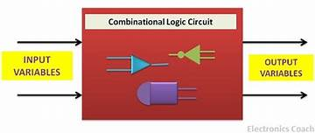
Combinational circuits and its industrial application
By : MD SHAKIL ANSARI

Slide 2
CONTENTS
INTRODUCTION
CONTENTS
WHAT A COMBINATIONAL CIRCUIT IS
COMBINATIONAL CIRCUITS & ITS VARIOUS TYPES
ADDERs (H.A & F.A)
SUBTRACTORs(H.S & F.S)
ENCORDERS
DECORDERS
MUX
DEMUX
APPLICATION OF COMBINATIONAL CIRCUITS
CONCLUSION

Slide 3
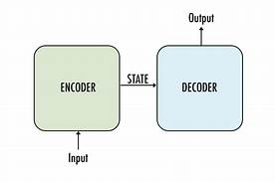
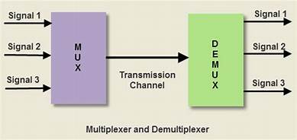
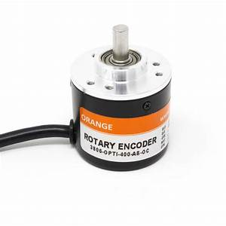
INTRODUCTION
Going through this PPT ,we'll see how the combinational circuits play
an important role in the design of any digital system .Digital systems
work on bits ,a binary information. Any digital system consists of various kinds of combinational & sequential circuits .

Slide 4
WHAT A COMBINATIONAL CIRCUIT IS...
A combinational circuit consist of logic gates whose outputs at any time are determined directly from the present combination of inputs without regard of previous inputs or outputs.
A combinational circuit performs specific information-processing operation specified logically by a set of Boolean Function.
The output function for a combinational circuit is basically a function of inputs.
In contrast with sequential circuit, combinational circuits are normally faster and less costly as it doesn't employ any memory elements.

Slide 5
COMBINATIONAL CIRCUIT AND ITS VARIOUS TYPES
Combinational circuits are found in various forms depending upon the application.Some fundamental combinational circuits are listed below.
ADDERS( HALF ADDER &FULL ADDER)
SUBTRACTOR(HALF SUBTRACTOR & FUL SUBTRACTOR)
ENCORDERS
DECORDERS
MULTIPLEXERS
DEMULTIPLEXERS
We'll see each type of combinational circuits in our next slide.

Slide 6
ADDERS
Adders are basically an arithmetic operation circuits which adds binary digits and produce the result which are used in digital computers.
Depending upon the number of bits it handles as operands ,Adders are of two types.
Half Adder- 2 bit addition : Adds 2 binary bits and produce the result as SUM and CARRY
Full Adder- 3 bit addition: Adds 3 bits (3rd bit is the carry of previous stage) and produce the result as SUM and CARRY.

Slide 7
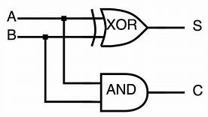
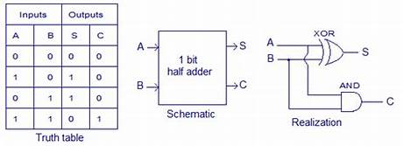
HALF ADDER
A combinational circuit which adds 2 binary digits and produce the SUM and CARRY as its output is known as HALF ADDER.
For 2 binary variables we have 4 possible combination and thus four different combination of addition is performed by the circuit.
S= A XOR B
C = A AND B

Slide 8
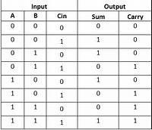
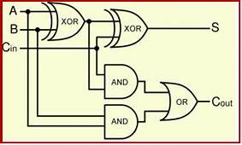
FULL ADDER
When the adder circuit deals with 3 input variables ,the adder so formed is called FULL ADDER.The 3rd input is basically the carry from the previous stage addition.
For 3 binary variables we have 8 possible combination and thus eight different combination of addition is performed by this circuit.

Slide 9
SUBTRACTOR
Subtractor are basically an arithmetic operation circuits which subtracts binary digits and produce the result which are used in digital computers.
Depending upon the number of bits it handles as operands ,Subtractors are of two types.
Half Subtractor- 2 bit subtraction : subtracts 2 binary bits and produce the result as SUM and BORROW
Full Subtractor- 3 bit subtraction: subtracts 3 bits (3rd bit is the borrow from previous stage) and produce the result as SUM and BORROW.

Slide 10
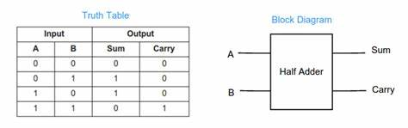
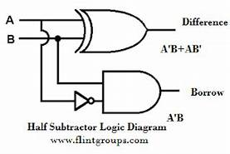
HALF SUBTRACTOR
A combinational circuit which subtracts 2 binary digits and produce the SUM and BORROW as its output is known as HALF SUBTRACTOR.
For 2 binary variables we have 4 possible combination and thus four different combination of subtraction is performed by this circuit.

Slide 11
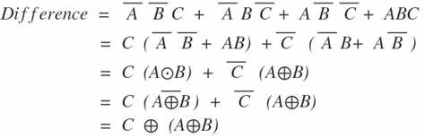
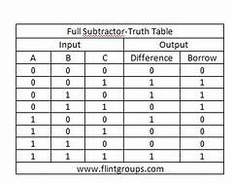
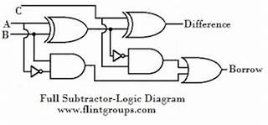

FULL SUBTRACTOR
A combinational circuit which subtracts 3 binary digits and produce the SUM and BORROW as its output is known as FULL SUBTRACTOR.
For 3 binary variables we have 8 possible combination and thus eight different combination of subtraction is performed by this circuit.

Slide 12
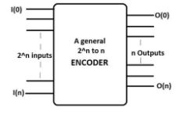
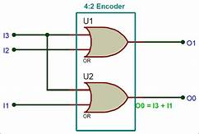
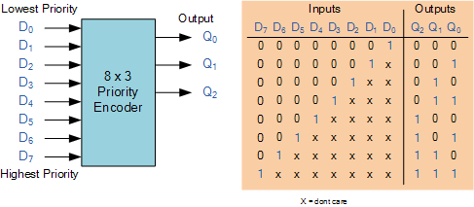
ENCORDER
Encorder is basically a combinational circuit which has many inputs and many outputs and is used to convert other code into binary code.
At a time only one input will be HIGH and the corresponding binary code will be given at the output side.
Few basic kinds of encorder are given as example below.
Octal to binary (8x3 encorder)
Hexadimal to binary (16x4 encorder)
Bcd to binary(10x4 encorder)

Slide 13
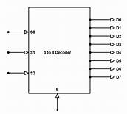
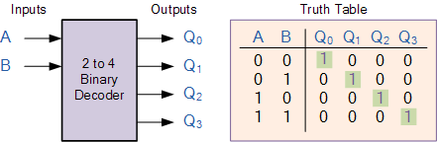
DECORDER
Decorder is basically a combinational circuit which has many inputs and many outputs and is used to convert binary code into any other code.
At a time all inputs will be HIGH representing a binary code and the corresponding other code will be given at the output side with only one output as HIGH .
Few basic kinds of decorder are given as example below.
Binary to octal (3x8 decorder)
Binary to hexadecimal (4x16 decorder)

Slide 14
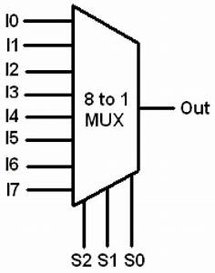
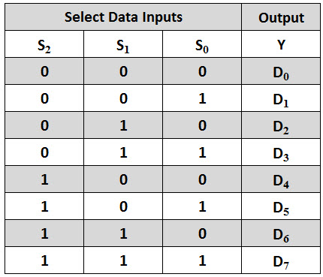
MULTIPLEXERS
MUX is a combinational circuit which has many input lines and single output line,depending upon the select lines ,one of the input lines is selected at a time and the data available on the input line will be tranferred to the output line.So it is also known as ….
Many to one circuit
Parrallel to serial data converter
OUTPUT:
Y=S2'S1'S0'D0+S2'S1'S0D1+S2'S1S0'D2+….........+S2S1S0D7

Slide 15
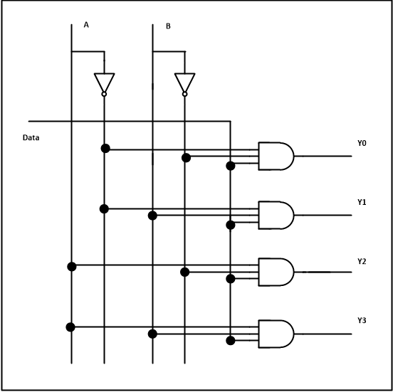
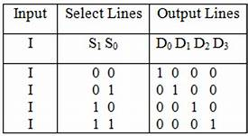
DEMULTIPLEXERS
DEMUX is a combinational circuit which has ONLY ONE input line and many output lines,depending upon the select lines ,one of the ouput lines is selected at a time and the data available on the input line will be tranferred to the selected output line.So it is also known as ….
One to many circuit
Serial to parallel data converter
OUTPUT:
D0= S1'S0'
D1= S1'S0
D2= S1S0'
D3= S1S0

Slide 16
INDUSTRIAL APPLICATION OF COMBINATIONAL CIRCUITS
Combinational circuits find their application in various digital systems which are readily used in industries nowadays.Most of the combinational circuits like adders and subtractors are used by digital calculator
Multiplexers and de-multiplexers are used in Synchronous Time Domain Multiplexing Technique, to achieve multi-line communication via single wire.
Decoders and Encoders are used to design RAM from registers to cut off the power consumption.

Slide 17
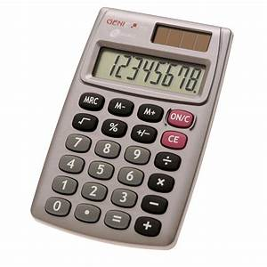
CONCLUSION
In this PPT,we've gone through several aspects of combinational circuits ,its types ,features,working and importance in designing digital system.Thus we can now conclude that digital systems employ combinational circuits as their building blocks to perform many complex problem.It's uses are so widely spreaded that we come across using these cicuits in calculators,memories etc.

Slide 18


